Slide 1
Information Security Public and Private Key Algorithms
Lecture 9
Razia Nisar Noorani &
Dr. Amir Mehmood

Slide 2
Secret Key Cryptography Problems
Traditional (secret key) cryptography uses a single key shared by both sender and receiver. This has some drawbacks:
If this key is disclosed communications are compromised - anyone who learns the method of encryption and gets the key.
Keys must be exchanged before transmission with any recipient or potential recipient of your message. So, to exchange keys you need a secure method of transmission, but essentially what you've done is create a need for another secure method of transmission. This means that you must either use a secure channel or meet in person in order to share this key. This can be a large problem, and is certainly less than convenient.

Slide 3
Public-Key Cryptography
Public-key (or two-key) cryptography involves the use of two keys:
A public-key, which may be known by anybody, and can be used to encrypt messages, and verify signatures
A private-key, known only to the recipient, used to decrypt messages, and sign (create) signatures

Slide 4
Alice, Bob and Trudy
In a Public Key system when Alice sends email to Bob, she finds his public key (possibly in a directory of some sort) and encrypts her message using that key. Unlike secret-key cryptography, though, the key used to encrypt will not decrypt the ciphertext. Knowledge of Bob’s public key will not help an eavesdropper. To decrypt, Bob uses his private key. If Bob wants to respond to Alice, he will encrypt his message using her public key.
Trudy (from Intruder) tries to disrupt the communication between Alice and Bob

Slide 5
Public-Key Cryptography Requirements
Knowing the public-key and public description of the cipher, it is still computationally infeasible to compute the private key
Thus the public-key may be distributed to anyone wishing to communicate securely with its owner

Slide 6
Public Key Encryption Systems
Because a different key is used on each side of the process, public key systems are also known as 'asymmetric systems'.
The distribution of keys for public key systems is generally much easier because it is not normally necessary to keep the public key secret.
The private key, on the other hand, must remain secret or else security is compromised.

Slide 7
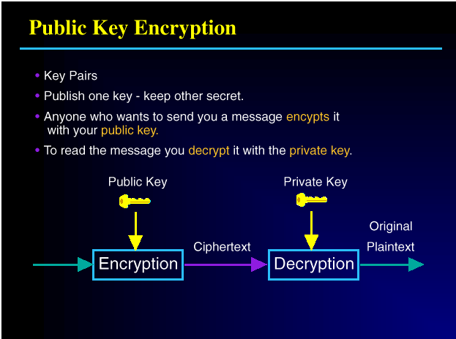

Slide 8
Comparison of SK and PK

Slide 9
Public Key Encryption Has Foundations in Mathematics
Public key crypto-systems were developed from some very subtle insights about the mathematics of large numbers and how they relate to the power of computers.
Public Key Encryption works because of what is known in math as a trapdoor problem.
A trapdoor is a mathematical formula that is easy to work forward but very hard to work backward.

Slide 10
Multiplication/Factorization Trapdoor Function
Public key algorithms depend on a person publishing a large public key and others being unable to factor this public key into its component parts.
Because the creator of the key knows the factors of his or her large number, he or she can use those factors to decode messages created by others using his or her public key.
Those who only know the public key will be unable to discover the private key, because of the difficulty of factoring the large number.

Slide 11
Inventors of PK Cryptography
Public Key Cryptosystem idea was invented independently by Whitfield Diffie and Martin Hellman, who presented their concept in 1976, and Ralph Merkle.
The first public-key algorithm was the Diffie-Hellman key exchange algorithm.
The first system which could do encryption/decryption as well as signatures was RSA.

Slide 12
Application of Public-Key Ciphers
Three important uses of public-key algorithms:
Public-Key Distribution Schemes (PKDS) - where the scheme is used to securely exchange a single piece of information
This value is normally used as a session key for a private-key scheme
Signature Schemes - used to create a digital signature only, where the private-key signs (create) signatures, and the public-key verifies signatures
Public Key Schemes (PKS) - used for encryption, where the public-key encrypts messages, and the private-key decrypts messages.

Slide 13

Diffie Hellman Key Exchange Algorithm

Slide 14
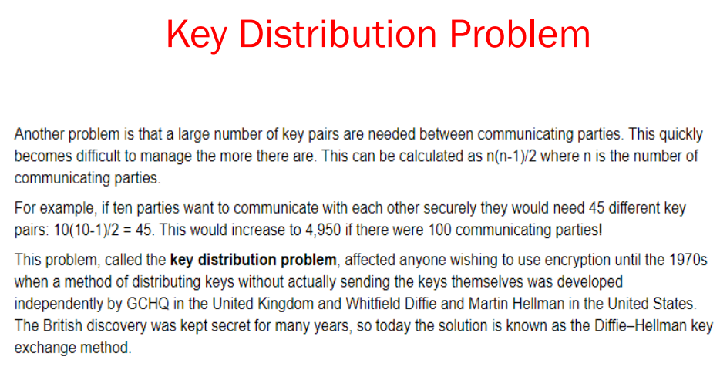

Slide 15
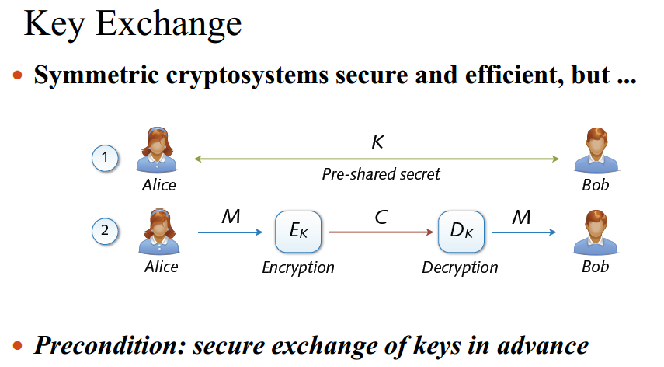

Slide 16

Diffie–Hellman Key Exchange
The purpose of the algorithm is to enable two users to securely exchange a key that can then be used for subsequent symmetric encryption of messages.
The algorithm itself is limited to the exchange of secret values.

Slide 17
Diffie–Hellman Key Exchange Illustration

Slide 18
Diffie-Hellman Key Agreement
Choose public numbers: q (large prime number), α (generator mod q)
A generates random X_{A} and sends B:
Y_{A} = α^{XA} mod q.
B generates random X_{B} and sends A:
Y_{B} = α ^{XB} mod q.
A calculates secret key: K = (Y_{B}) ^{XA} mod q.
B calculates secret key: K = (Y_{A}) ^{XB} mod q.

Slide 19
What’s a generator?
α is a generator mod q if for all 0 ≤ n < q, there is some 1 ≤ m < q such that
α^{m} = n mod q
Is m unique?
Yes: Proof by counting.
Discrete logarithm: given α, n, and q find 0 ≤ m < q such that α^{m} = n mod q.

Slide 20
Example
What is a generator for q = 11?
2¹ ≡₁₁ 2 2⁶ = 64 ≡₁₁ 9
2² ≡₁₁ 4 2⁷ = 128 ≡₁₁ 7
2³ ≡₁₁ 8 2⁸ = 256 ≡₁₁ 3
2⁴ = 16 ≡₁₁ 5 2⁹ = 512 ≡₁₁ 6
2⁵ = 32 ≡₁₁ 10 2¹⁰ = 1024 ≡₁₁ 1
Q=5
4^1 mod 5=4
4^2 mod 5=1
4^3 mod 5 =4
4^4 mod 5 = 1
Q = 5
2^1 mod 5 = 2
2^2 mod 5= 4
2^3 mod 5=3
2^4 mod 5=1
Q=5
3^1 mod 5=3
3^2 mod 5=4
3^3 mod 5 =2
3^4 mod 5 = 1
If q is prime, there must be a generator.

Slide 21
Diffie-Hellman Example
Choose public numbers: q (large prime number), α (generator mod q):
q = 11, α = 2
A generates random X_{A} and sends B:
Y_{A} = α^{XA} mod q.
X_{A} = 4, Y_{A} = 2⁴ mod 11 = 16 mod 11 = 5
B generates random X_{B} and sends A:
Y_{B} = α ^{XB} mod q.
X_{B} = 6, Y_{B} = 2⁶ mod 11 = 64 mod 11 = 9
Example from Tom Dunigan’s notes: http://www.cs.utk.edu/~dunigan/cs594-cns00/class14.html

Slide 22
Diffie-Hellman Example, cont.
q = 11, α = 2
X_{A} = 4, Y_{A} = 5 X_{B} = 6, Y_{B} = 9
A calculates secret key: K = (Y_{B}) ^{XA} mod q.
K = 9⁴ mod 11 = 6561 mod 11 = 5.
B calculates secret key: K = (Y_{A}) ^{XB} mod q.
K = 5⁶ mod 11 = 15625 mod 11 = 5.

Slide 23
Is it magic? Things to Prove:
They generate the same keys:
K = (Y_{B}) ^{XA} mod q = (Y_{A}) ^{XB} mod q
An eavesdropper cannot find K from any transmitted value:
q, α, Y_{A}, Y_{B}

Slide 24
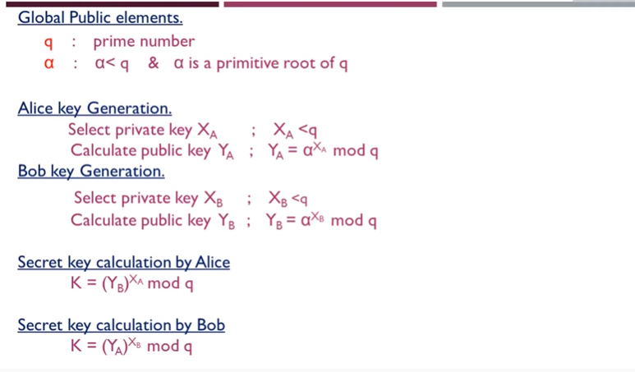

Slide 25
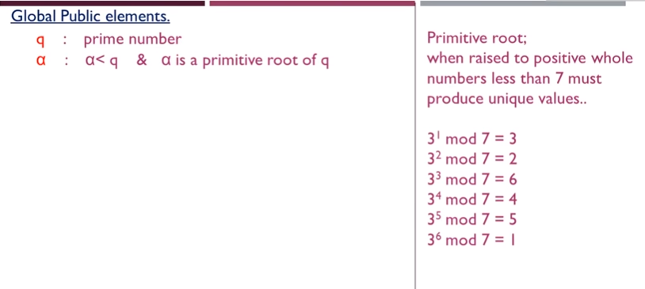

Q = 7
2^1 mod 7 = 2
2^2 mod 7= 4
2^3 mod 7=1
2^4 mod 7=2
2^5 mod 7 = 4
2^6 mod 7= 1

Slide 26
Since we archieved all values from 1 to 10 in our residue results, then 2 is a primitive root of 11
g = 2
n | g^{n-1} mod p
1 | 2¹⁻¹ mod 11 = 1
2 | 2²⁻¹ mod 11 = 2
3 | 2³⁻¹ mod 11 = 4
4 | 2⁴⁻¹ mod 11 = 8
5 | 2⁵⁻¹ mod 11 = 5
6 | 2⁶⁻¹ mod 11 = 10
7 | 2⁷⁻¹ mod 11 = 9
8 | 2⁸⁻¹ mod 11 = 7
9 | 2⁹⁻¹ mod 11 = 3
10 | 2¹⁰⁻¹ mod 11 = 6
The number 11 is a primitive root of the prime number 2.

Slide 27
Since we did not archieve residue values of (2,6,7,8,10), then 3 is NOT a primitive root of 11
g = 3
n | g^{n-1} mod p
1 | 3¹⁻¹ mod 11 = 1
2 | 3²⁻¹ mod 11 = 3
3 | 3³⁻¹ mod 11 = 9
4 | 3⁴⁻¹ mod 11 = 5
5 | 3⁵⁻¹ mod 11 = 4
6 | 3⁶⁻¹ mod 11 = 1
7 | 3⁷⁻¹ mod 11 = 3
8 | 3⁸⁻¹ mod 11 = 9
9 | 3⁹⁻¹ mod 11 = 5
10 | 3¹⁰⁻¹ mod 11 = 4
The number 11 is not a primitive root of the prime number 3.

Slide 28
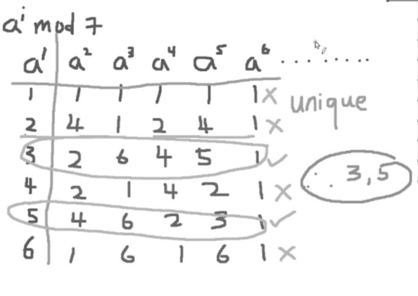

Slide 29
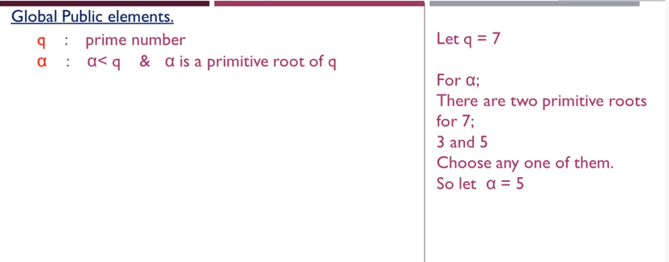

Slide 30
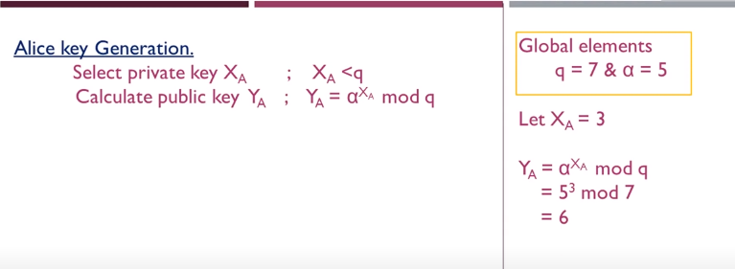

Slide 31
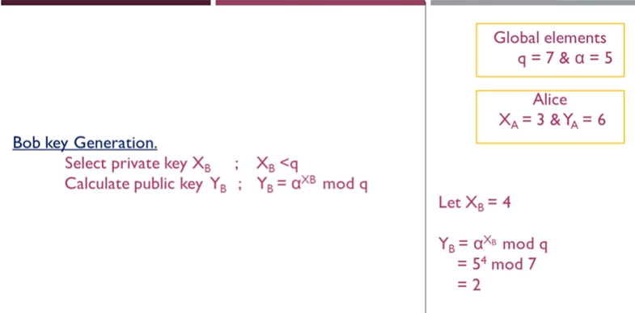

Slide 32

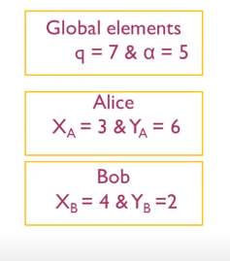

Slide 33
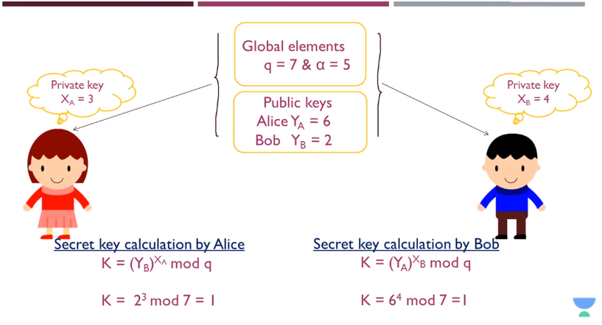

Slide 34
Secrecy Chart
g = public (prime) base, known to Alice, Bob, and Eve (eavesdropper).
g = 5
p = public (prime) modulus, known to Alice, Bob, and Eve.
p = 23
a = Alice's private key, known only to Alice.
a = 6
b = Bob's private key known only to Bob.
b = 15
A = Alice's public key, known to Alice, Bob, and Eve.
A = ga mod p = 8
B = Bob's public key, known to Alice, Bob, and Eve.
B = gb mod p = 19

Slide 35
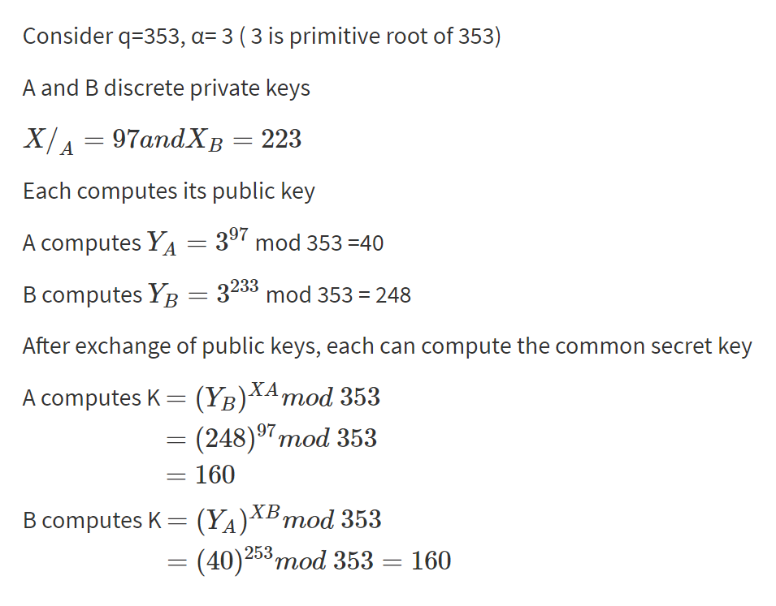
Another Example
q = 353
α= 3
Xa = 97
Xb =223
Ya = 3^97 mod 353 = 40
Yb = 3^223 mod 353 = 125
Ka= yb^(xa) mod 353
Ka = 125^97 mod 353 = 77
Kb = ya^(xb) mod 353
Kb =40^223 mod 353 = 77

Slide 36
Diffie-Hellman Use
SSL
Cisco encrypting routers
Sun secure RPC
etc...

Slide 37
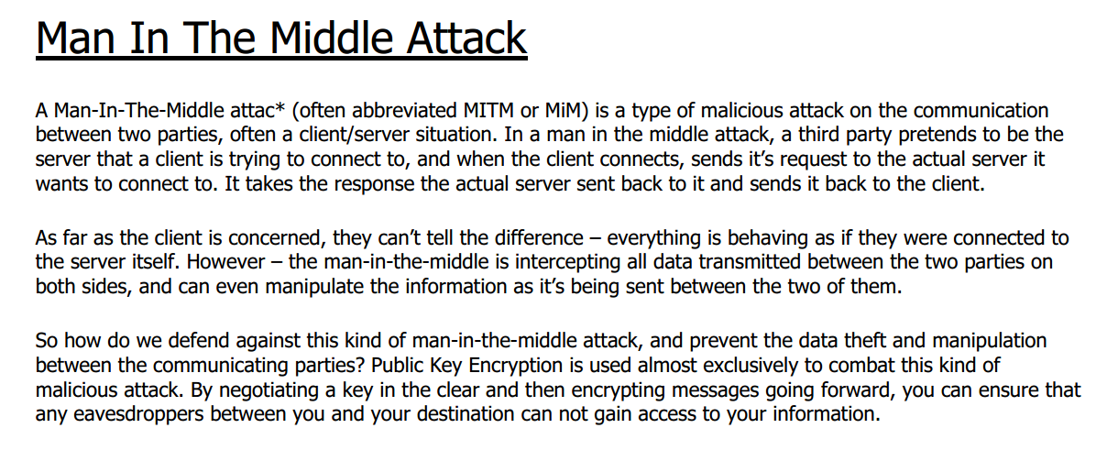

Slide 38
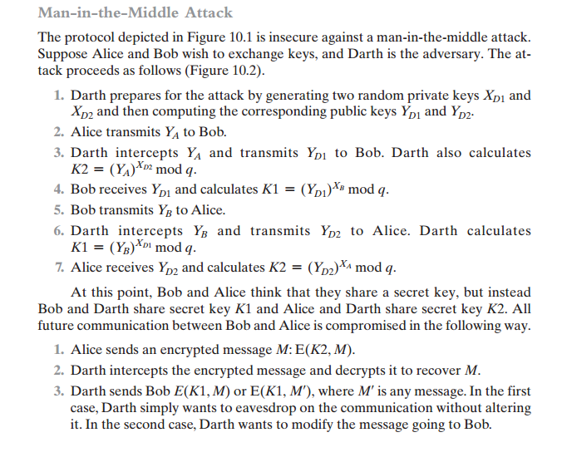

Slide 39
